Slide 1
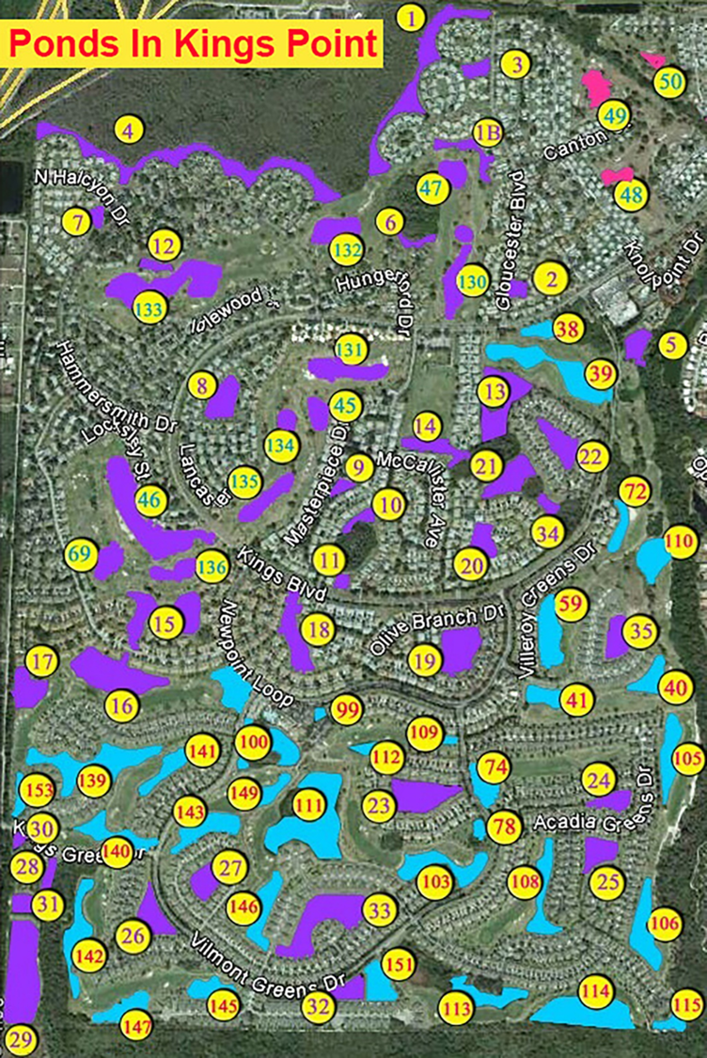
Kings Point storm water ponds History and Management
Kings Point Master Association Pond Committee - Seminar #6
By: Rob Davies and Jason Jasczak

Slide 2
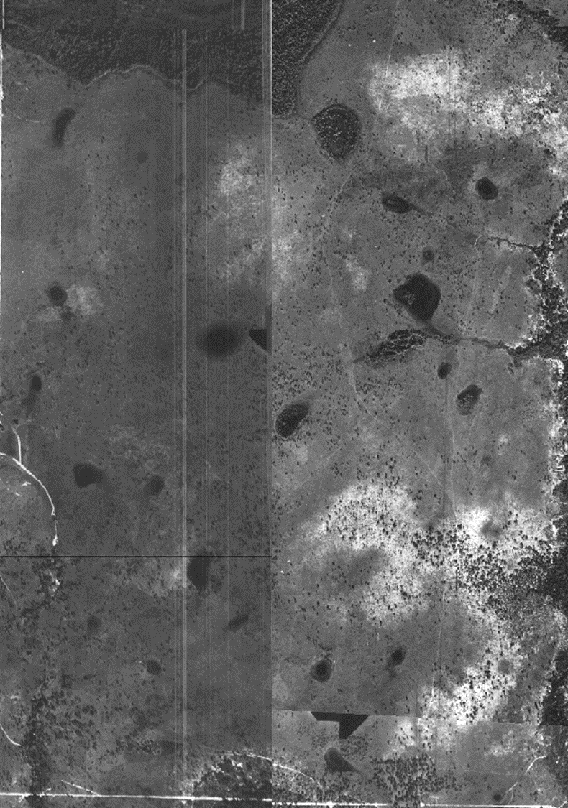
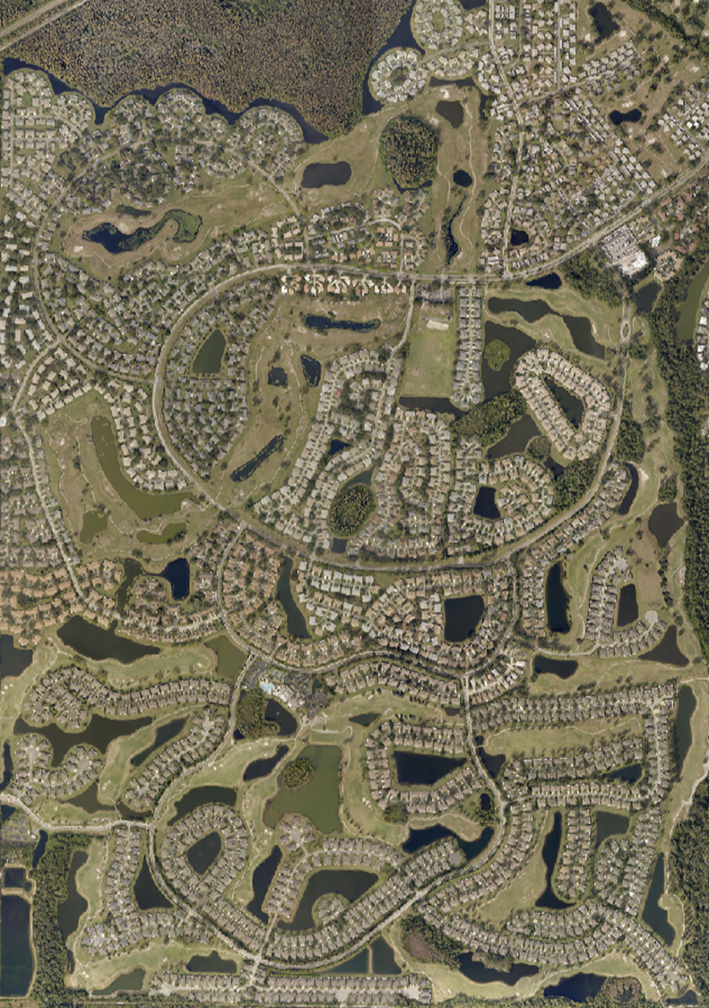
Kings Point 1933 VS Today

Slide 3
What is the stormwater rule in Florida?
Florida's stormwater rules were developed to meet a performance standard of reducing the average annual post-development stormwater pollutant loading of Total Suspended Solids (TSS) by 80%, or by 95% for stormwater discharges directly into Outstanding Florida Waters. 1980s
Southwest Florida Water Management District (WFWMD)

Slide 5
The landscaped zone
Eliminate pesticides, herbicides and fertilizers within 10’ of the pond
Mulch bare soil to eliminate runoff
Clean up yard debris and pet wastes to eliminate bacteria and nutrient flow into pond
Do not run gutters and downspouts into ponds. End them onto lawn or under trees for absorption

Slide 6
The Vegetative Buffer Zone
The buffer zone refers to the area directly on the shoreline above the littoral shelf, extending several feet in elevation. A healthy buffer zone contains native grasses and flowering plants with complex root systems that hold soil in place. These beneficial buffer plants not only prevent erosion but also help filter out the debris and pollutants contained in stormwater runoff.
.

Slide 7
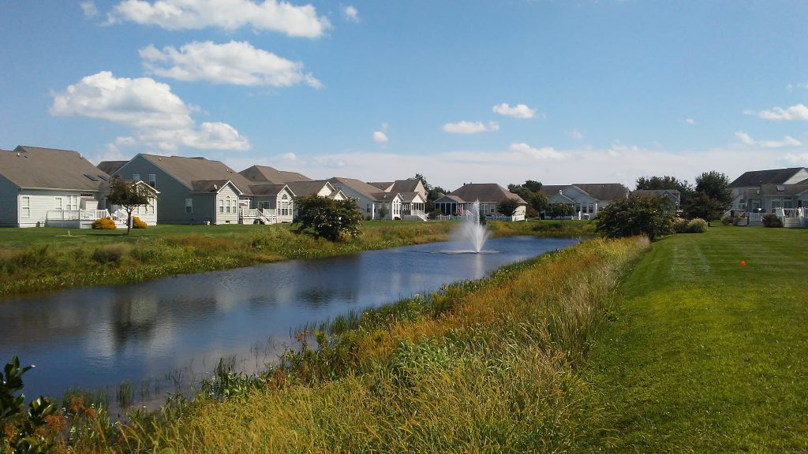

Slide 8
Littoral zone - is the sloped “shelf” that connects water to land. Sunlight penetrates through the entire water column in this shallow area. When healthy, the littoral zone can resemble a miniature wetland consisting of native plants that increase dissolved oxygen and create vital habitat for beneficial fish and organisms. Typically, the littoral zone reflects the health of the entire aquatic ecosystem.

Slide 9
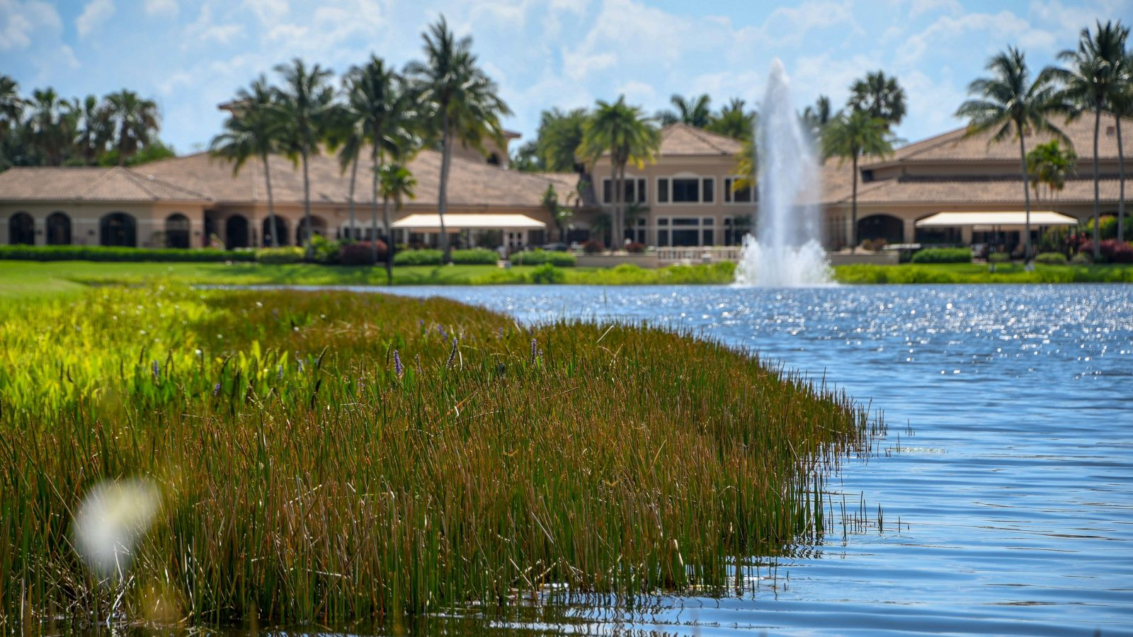

Slide 10
Kings Point pond permit #291496019
Filed in l980s
Requires all ponds to be at least 10% planted
From .5’ above to 2.5’ below water surface
Of the 57.3 acres of pond 13.55 acres of it must be planted for 23.7 % coverage

Slide 11
Permit continued
Requires annual inspection to assure 85% survival rate of plants
Owners (KP) will be responsible to maintain a 75% plant cover in the ponds for as lond as t he lake system is operated

Slide 12
Status of KP ponds
Mild to severe shoreline erosion causing steep banks and decreasing water depth and pond capacities.
Non-compliant with requirements of permit requirements.
Need to develop a regular testing schedule for nutrients, dissolved oxygen, nitrogen and phosphorous.
Generally in fairly good health given lack of attention in the past.

Slide 13
Next steps
Implement improved monitoring of each pond
Continuing littoral zone plantings over time
Encourage no mow buffer zones around each pond
Develop individual ‘Adopt of Pond’ activities
Continue educational activities
Seek grants to offset improvement activities.

Slide 14
Pond #3 – Landscape Plantings, Oak Trees, Gulf Coast Spike Rush , Duck Potato and Pickerelweed.

Slide 15
Pond #6 - Mild shoreline erosion with Spike Rush starting to protect the shoreline. Island forming in front of stormwater inlet pipe.

Slide 16
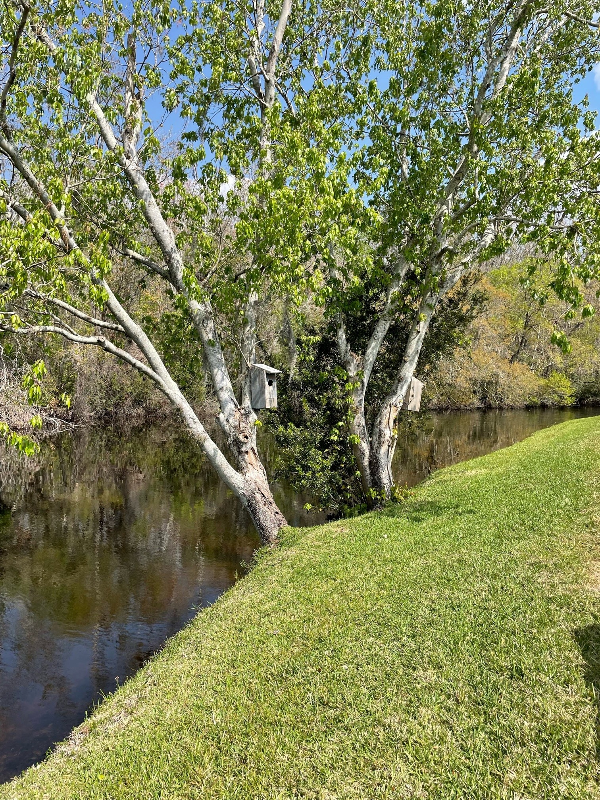
Pond #6 - Water shaded by trees, a pair of ducks across pond on the woods, and an unidentified Plant.

Slide 17
Pond off Hammersmith - Trees planted, small patch of Spike Rush, no shoreline protection.

Slide 18
Pond # 15 - Very shallow, lots of filling in due the steep banks.

Slide 19
Pond #100 - Spike Rush and Duck Potato.

Slide 20
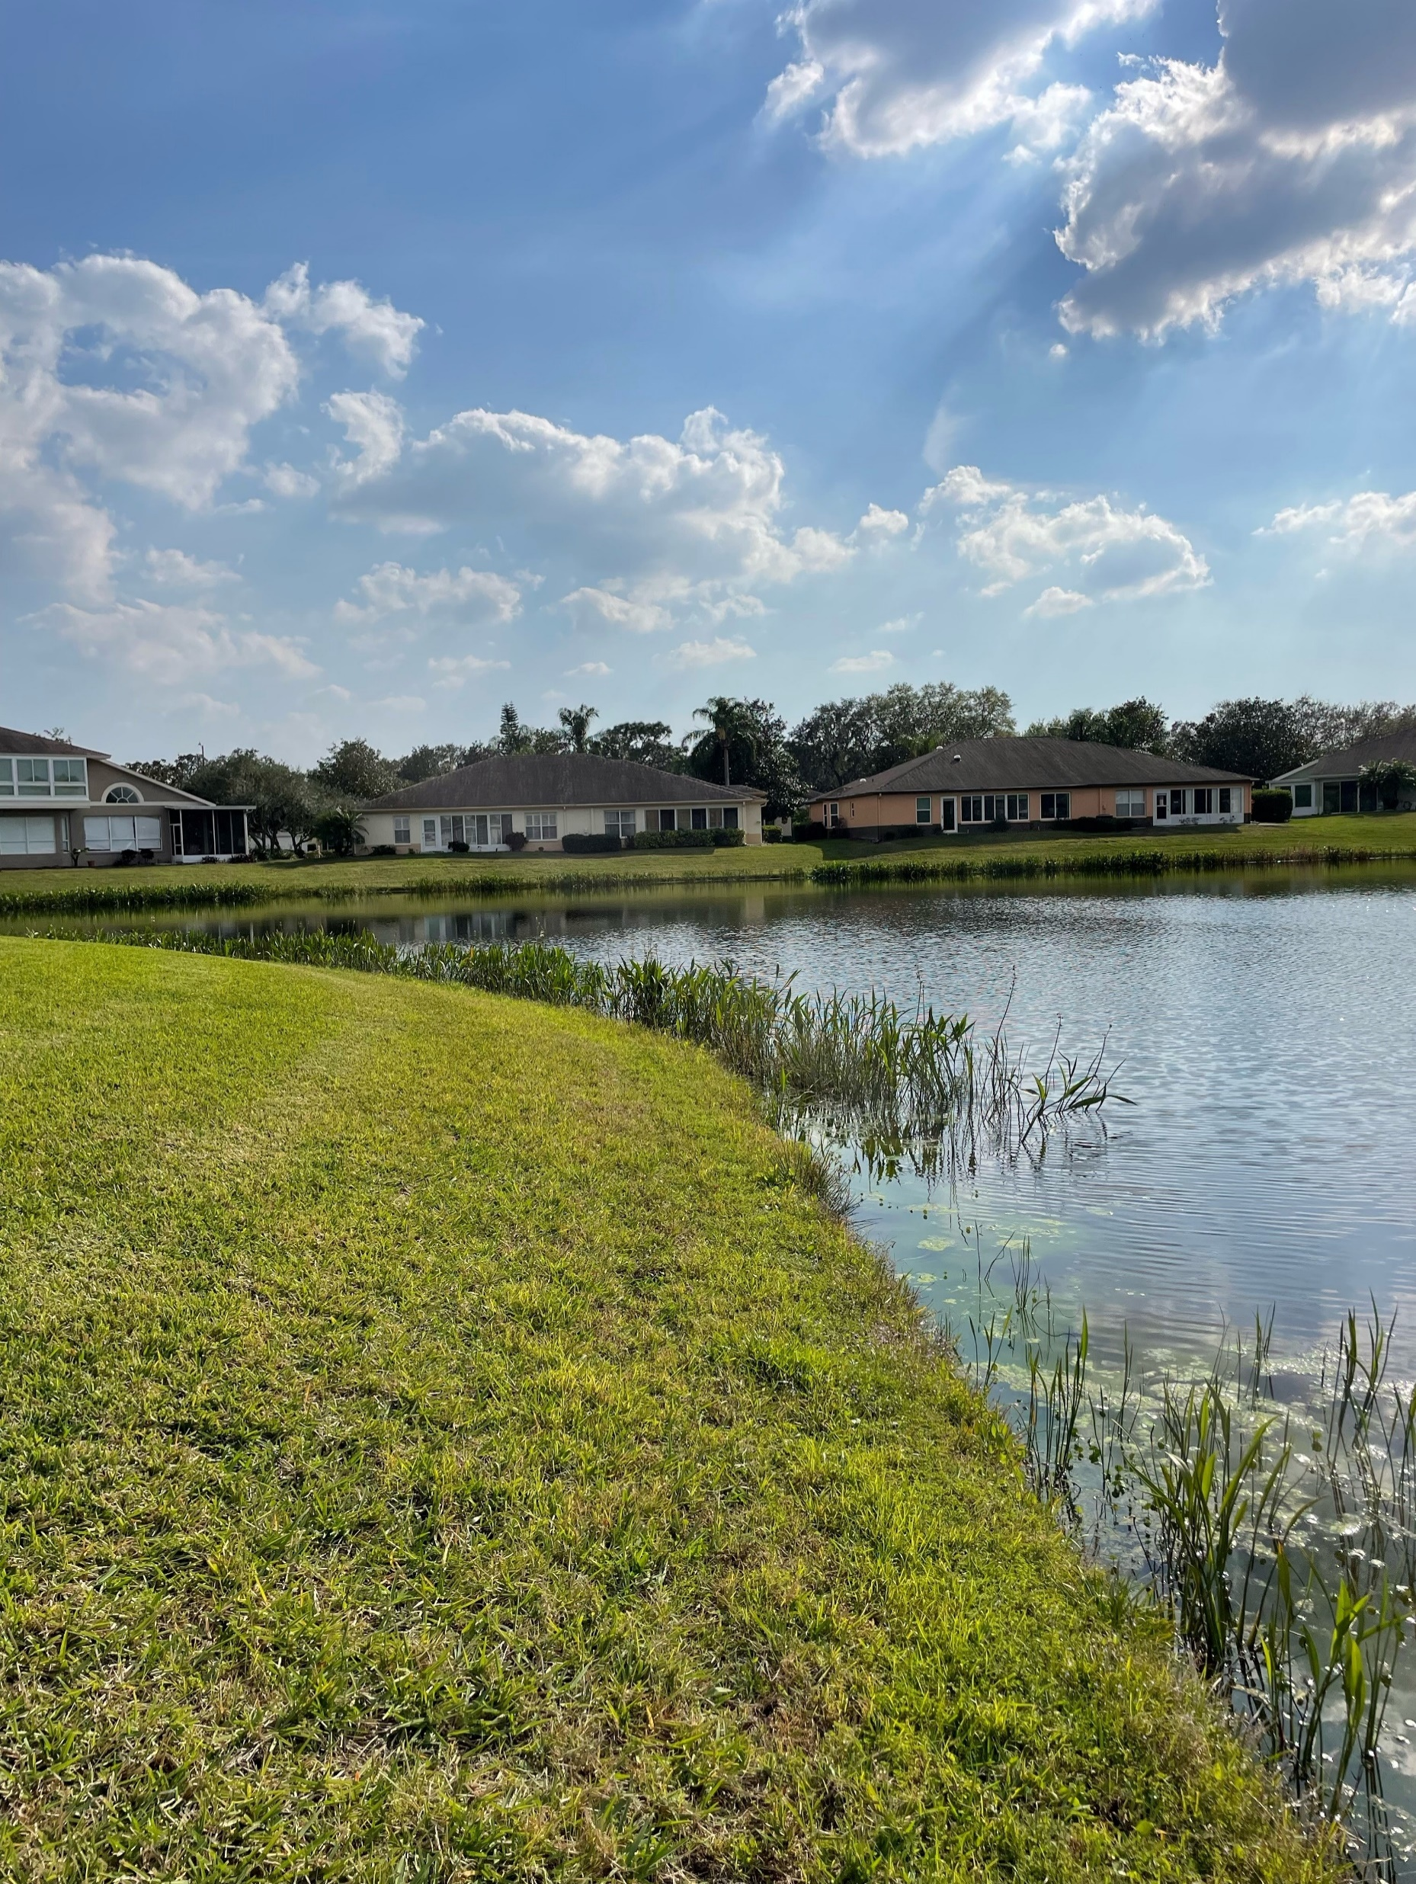
Pond #20 – Ringed with Duck Potato plants.

Slide 21
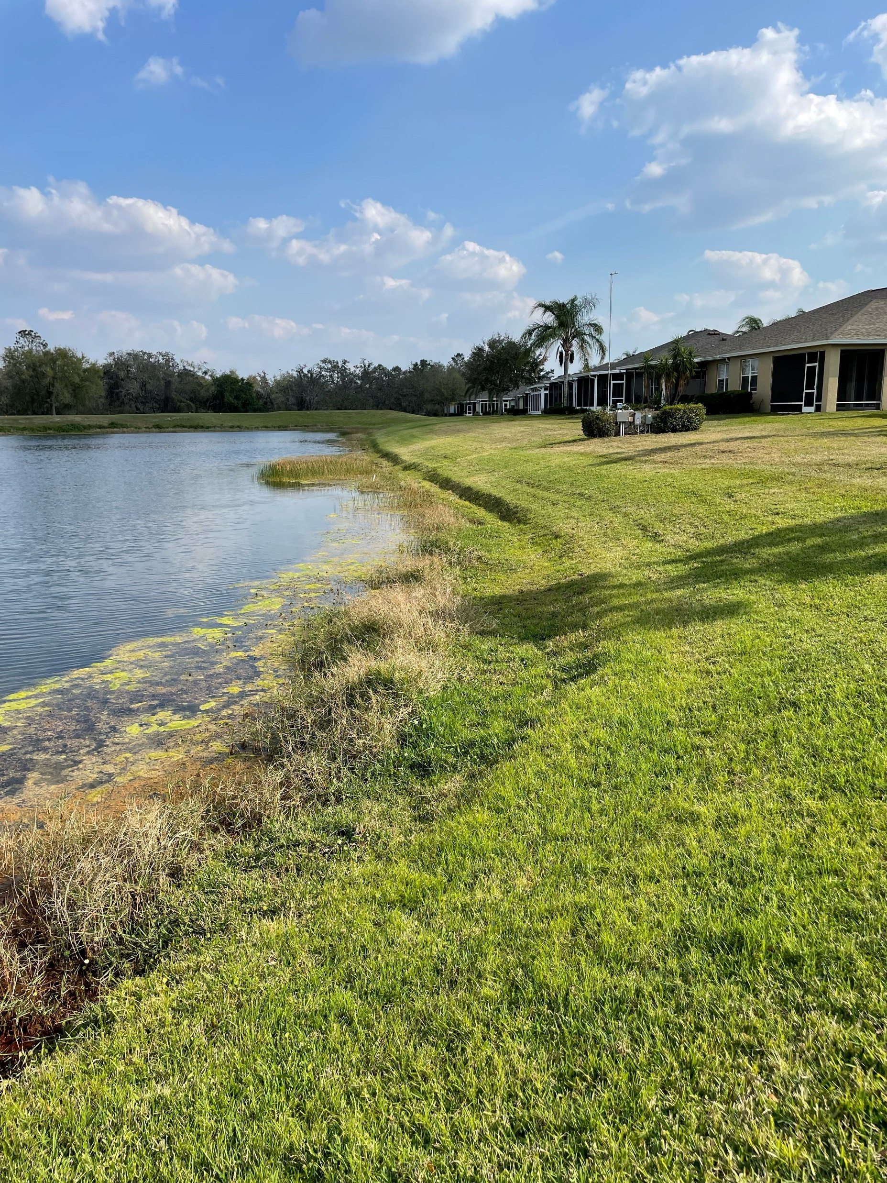
Pond #106 – End of a chain of Ponds and discharges into Cypress Creek.

Slide 22
If you have any questions, please feel free to contact me, Rob Davies @ robdaviessailing.com or visit kpmaster.com/ponds for more information. THANK YOU FOR COMING!

